Slide 1
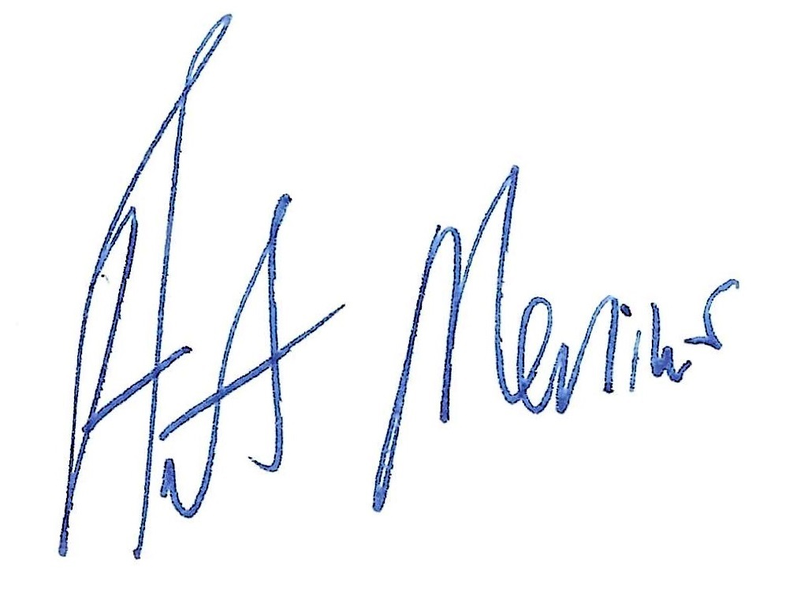
Working Narratives Sponsorship Development

Slide 2
Project materials website: https://artmenius.com/working-narratives-sponsorship-materials/

Slide 3
“The power of sponsorship comes from creating a genuine, longstanding connection between the brand and the fans and that’s accomplished by consistency” - Frank Vuouno of 16W

Slide 4
Why Event Marketing
Event marketing plays a key role in marketing mix because it touches the consumer on a much deeper level compared to other forms of communication
  Events perceived as hybrid internet/dealer visit vs. traditional communication
  Complements and adds to other elements of the marketing mix, particularly advertising (synergy)
Event marketing’s power is in providing an interactive product experience
  Seeing, touching, feeling, smelling -- prerequisite to serious consideration or purchase intention
“Sponsorship can be very effective at extending brands beyond tangible attributes because they develop associations that add depth, richness, and a contemporary feel to the brand and its relationship with customers”
  Aaker & Joachimsthaler, 2000, p.203

Slide 5
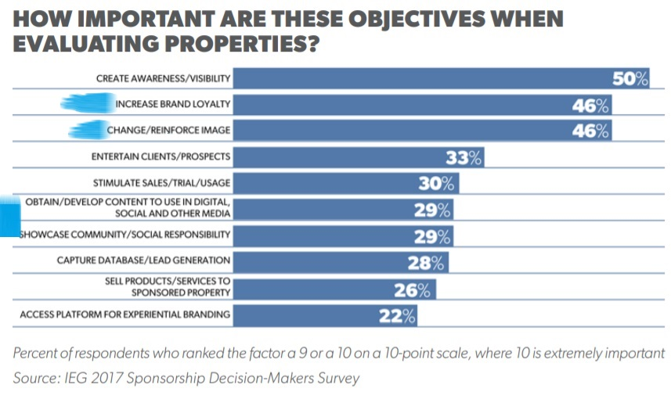

Slide 6
SERFA Sponsorship Case Statement
For its 12th year, the SERFA (South East Regional Folk Alliance) Conference is moving to an exciting new location – The Chattanoogan Hotel in Chattanooga. Our new venue allows for expansive growth and expanded opportunities for you to promote your [business]. The SERFA Conference has established itself as the gateway to the folk community and folk music business in the south east, attracting attendees from throughout the USA and Canada. SERFA delivers a highly targeted audience and efficient ways of reaching them including exhibits, advertising, announcements, signage, and placement in promotional materials and a collaborative approach to activation. SERFA offers a range of sponsorship properties across the breadth of the event and at price points that can work for almost all budgets.

Slide 7
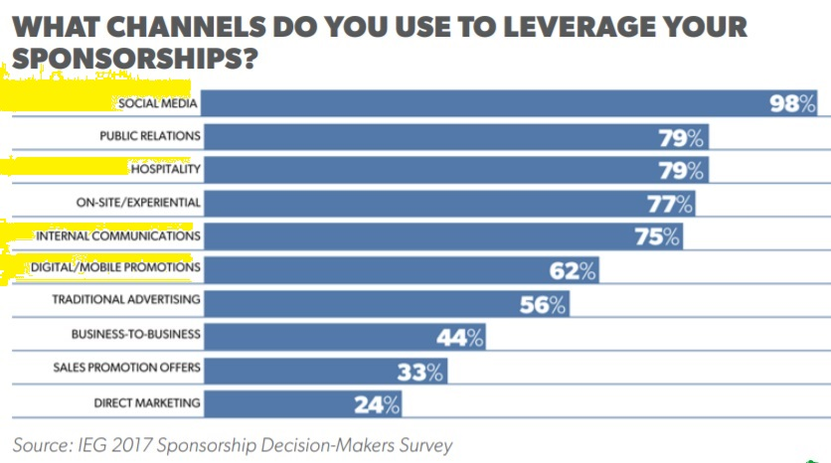

Slide 8
  Examples of properties
  title or presenting sponsorships
  festival program books, web site, and electronic newsletters
  services such as lost & found
  raffles and auctions
  title sponsorships of stages and specific events
  official partners

Slide 9
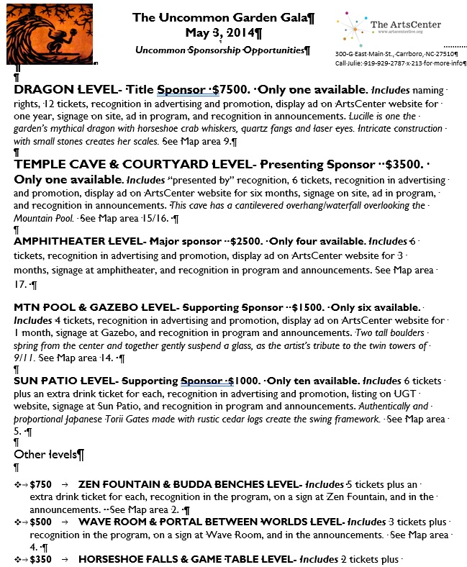

Slide 10
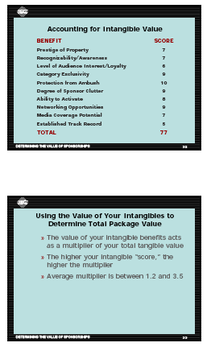

Slide 11
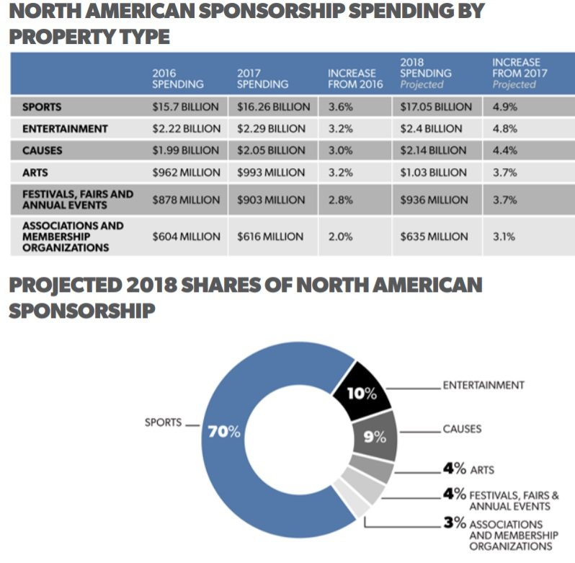

Slide 12


Slide 13
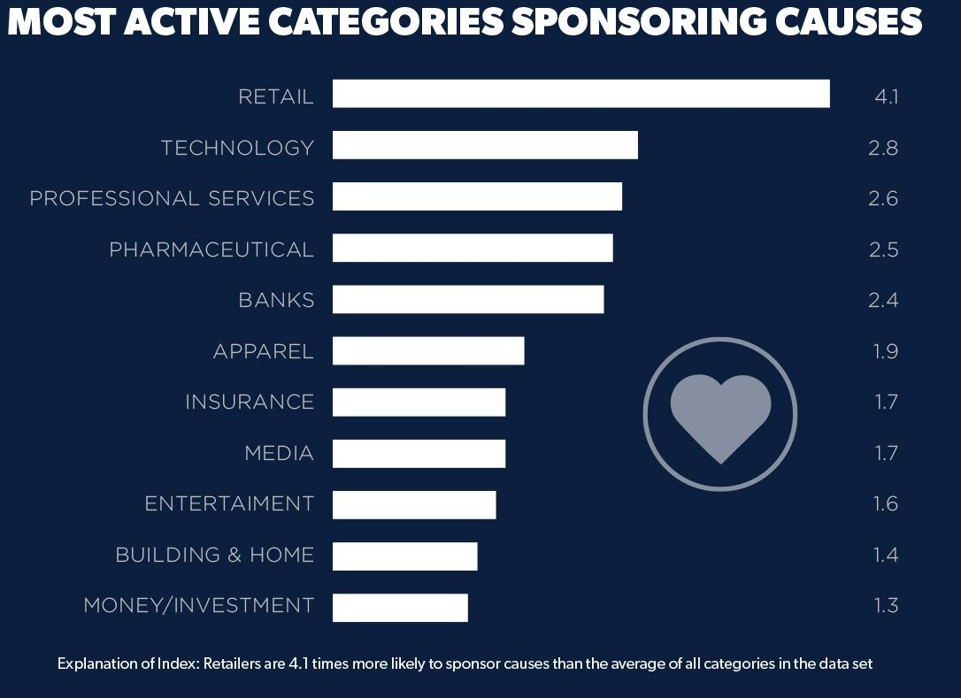

Slide 14
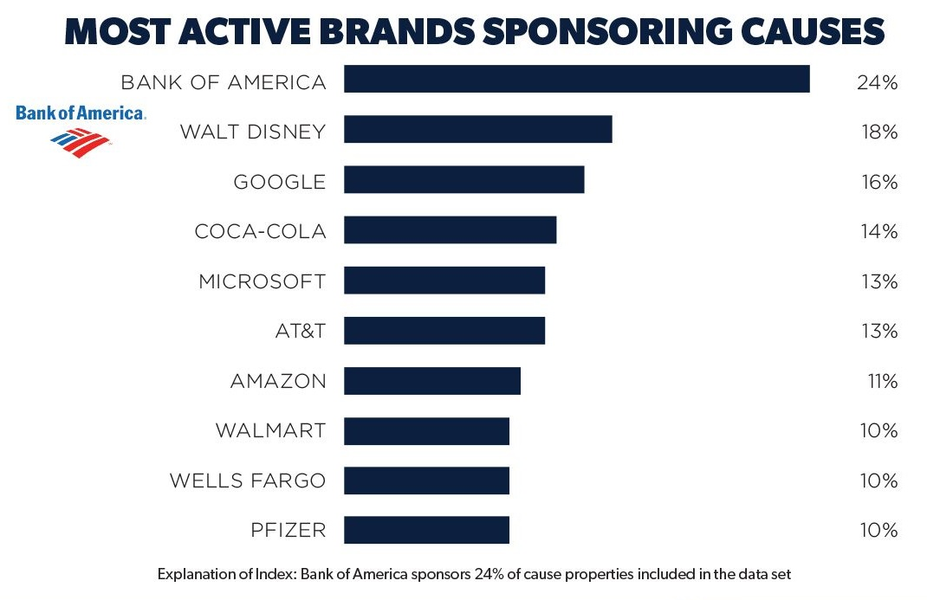

Slide 15
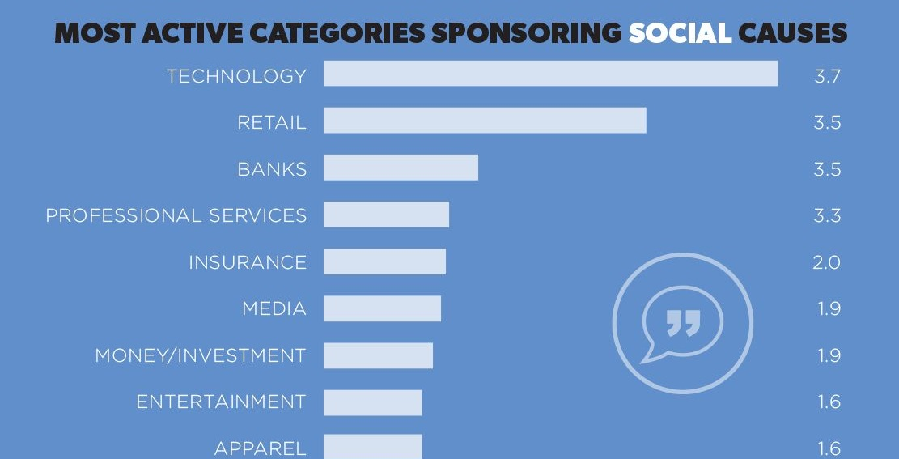

Slide 16
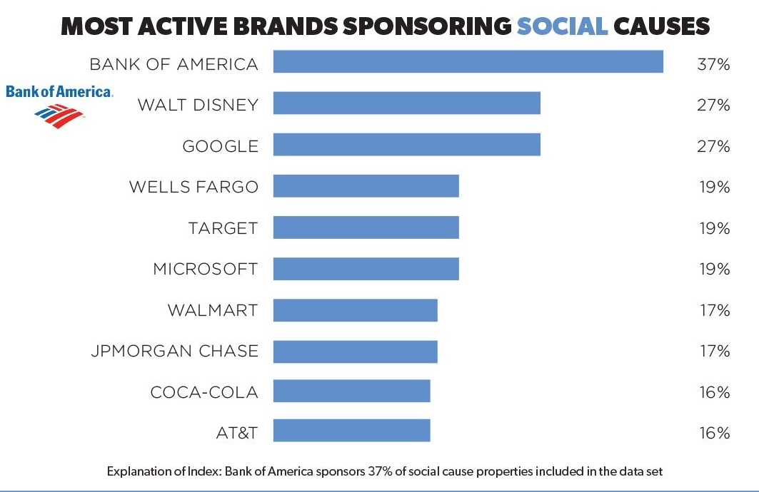

Slide 17
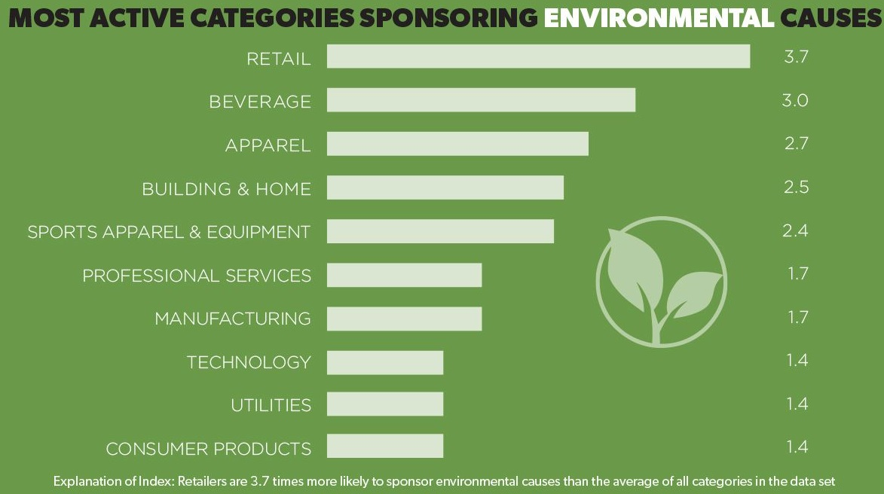

Slide 18
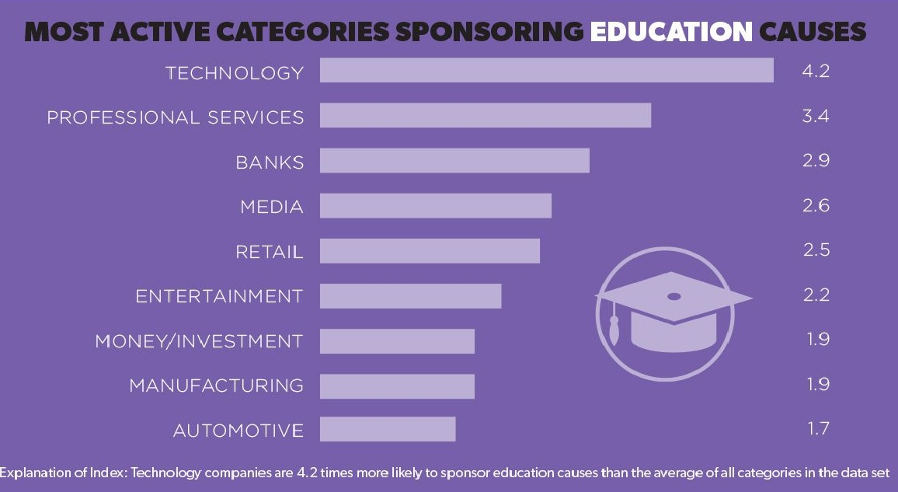

Slide 19
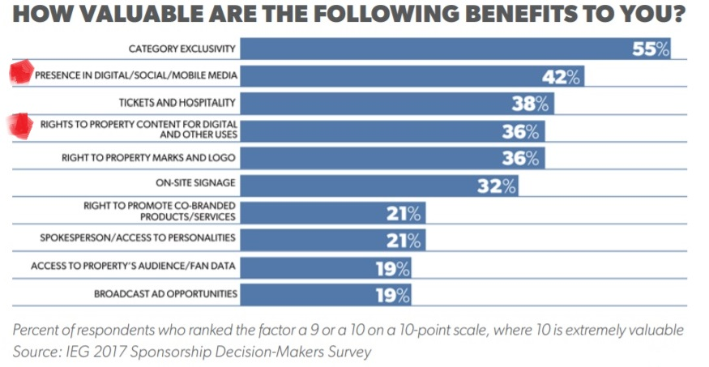

Slide 20
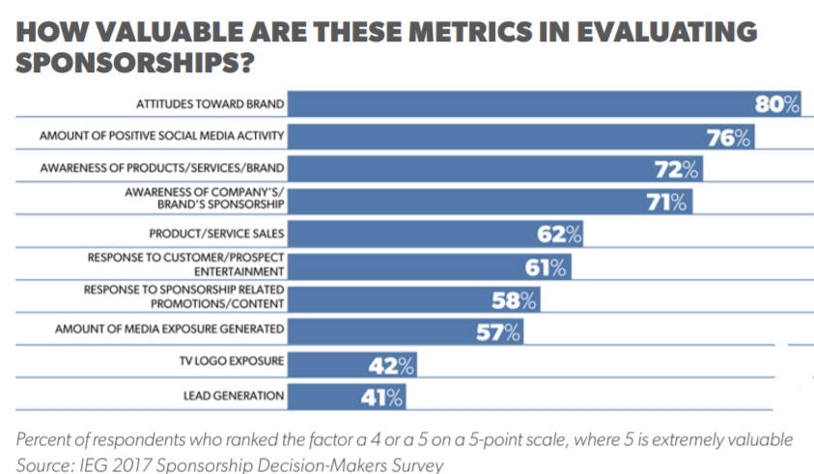

Slide 21
the Five Key Facts about potential sponsors –
what they need
their budget
who makes the decisions
when
how you will follow-up
& One Impression –
where is their pain.

Slide 22
Evaluating Sponsor Prospects 18-25 Points = Quality Prospect 13-17 Points = Viable Prospect Less than 13 = Poor Prospect | High (5) | Medium (3) | Low (1) | None (0) | Total
Mission or Cause Match
Relationship
Sponsors local causes
Image Match
Their Problems We Solve
Demographic Match

Slide 23
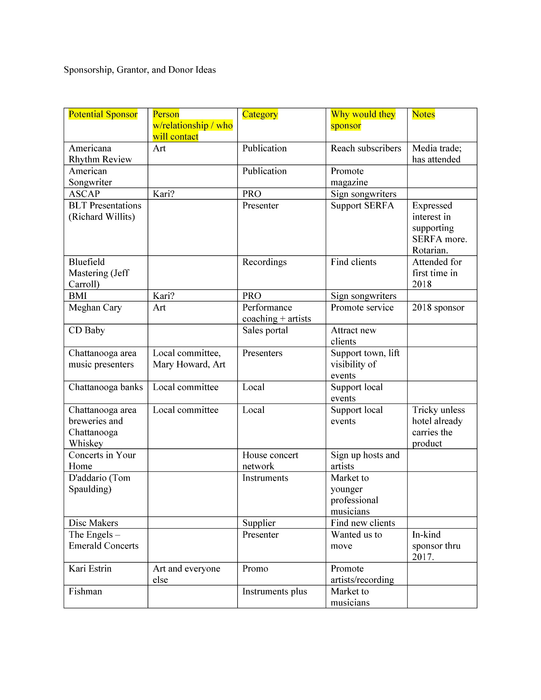

Slide 24
Hunting: Be active and involved in the community
v Join the Chamber of Commerce, attend its events, serve on committees, and use its networking opportunities. Watch and use the list of new members religiously.
v Go on the rubber chicken circuit and demonstrate the value of your event to the community, artistically and economically.
v Look for companies that have a need in your market such as to rebuild a tarnished image or establish a new store.
v See who is sponsoring other events in your community
v Local franchises are the best route to major corporations

Slide 25
Hunting: Lead Generators
v Recommendations from satisfied sponsors, including those who have been forced to discontinue by outside forces
v Established contact people who have moved to new sponsors
v Media sales people familiar with your event
Recommendations from prospects who ultimately had to pass
Local business section of your newspaper

Slide 26


Slide 27
The Opportunity Summary
Sells the prospect on seeing full proposal
Briefly describes the demographics, event, its benefits and why sponsor would be a good fit.
Just covers the basics, with back up materials
It does not discuss the specifics
Contains a call to action

Slide 28
Proposal Contents
The specific sponsorship being pitched
The sponsorship fee or in-kind and date due
The itemized deliverables from the sponsee:
Credentials and parking
Signage
Advertising and credits
Web presence
On site presence
A call to action as they close, detailing when you will contact them to discuss the proposal.

Slide 29
Elements of the Contract
Basic deal, fee & date due, invoice
Credentials, parking, & special access
Real and electronic signage
Advertising, announcements, rights to mark
Web site exposure
Renewal rights, on site presence, lodging, shipping info
Termination clause
Legal boilerplate
Addenda, exhibitor rules, and forms

Slide 30
Why Sponsors Renew
Internal Feedback 88%
Sales bounce back 56%
Print media analysis 51%
TV exposure 46%
Dealer response 43%
Primary consumer research 42%

